Slide 1
Introduction to Quantum Computing: From a Layperson to a Programmer in 30 Steps
Hiu-Yung Wong
https://link.springer.com/book/10.1007/978-3-030-98339-0
https://www.amazon.com/Introduction-Quantum-Computing-Layperson-Programmer/dp/3030983382
Playlist: https://www.youtube.com/watch?v=ysiyYCiQdpw&list=PLnK6MrIqGXsJfcBdppW3CKJ858zR8P4eP&index=9
https://www.youtube.com/watch?v=h59TUm7AmL4&list=PLnK6MrIqGXsJfcBdppW3CKJ858zR8P4eP&index=10
https://www.youtube.com/watch?v=bNTk1PxmSSs&list=PLnK6MrIqGXsJfcBdppW3CKJ858zR8P4eP&index=11

Slide 2
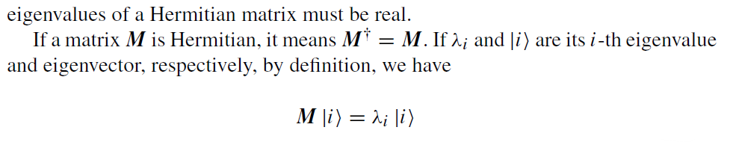
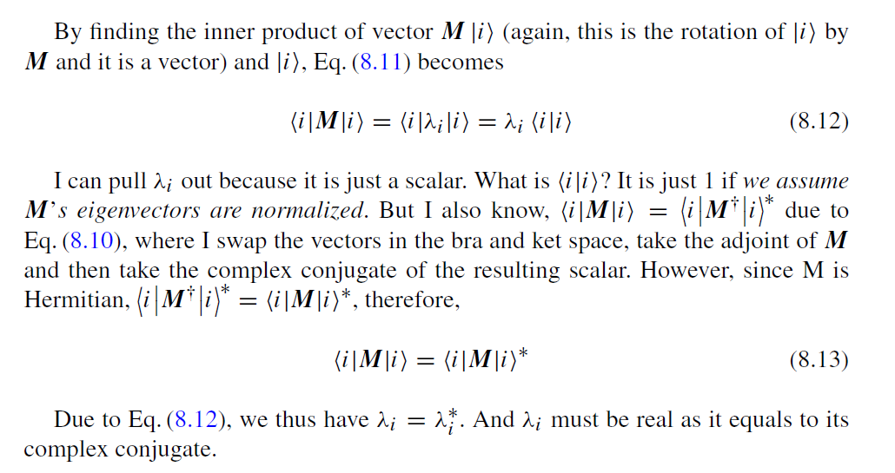
Self-Adjoint/Hermitian Matrix and its Eigenvalue
Claim

Slide 3
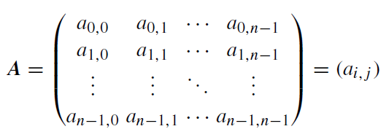
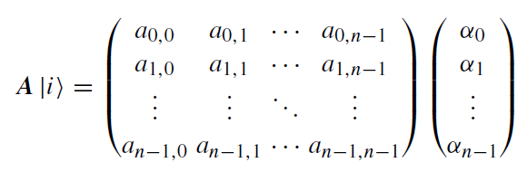
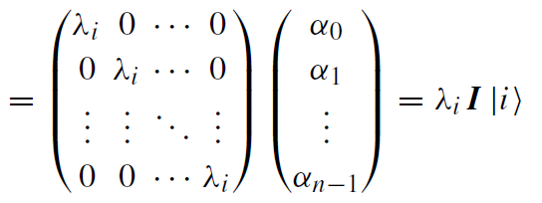
Matrix Diagonalization and Eigenvalues (2nd method to find eigenvalues)

Slide 4
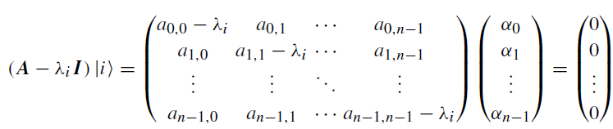
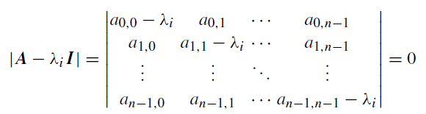
Matrix Diagonalization and Eigenvalues
If we represent the matrix in the basis formed by its eigenvectors, the matrix is diagonal.
So diagonalizing a matrix is equivalent to find its eigenvalues/eigenvectors.

Slide 5
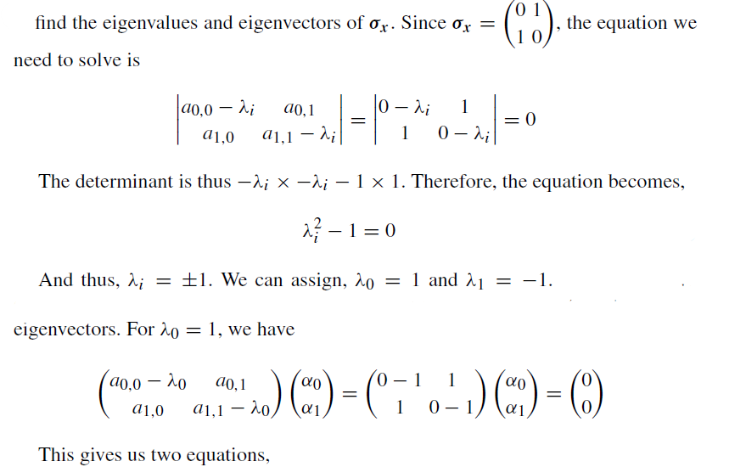
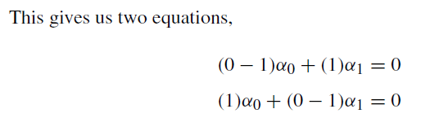


Matrix Diagonalization and Eigenvalues Numerical Example

Slide 6
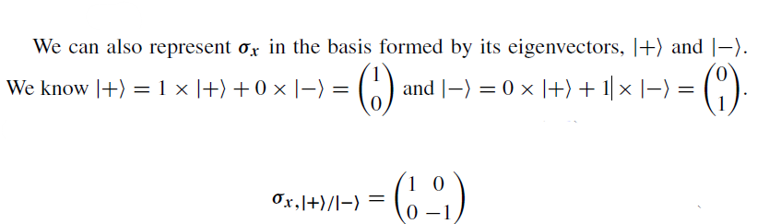
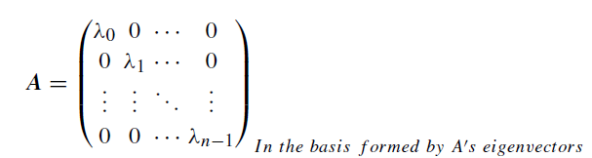
Represent σ_{x} in the Basis formed by its Eigenvectors

Slide 7



Unitary Matrix and Transformation
their inner product is unchanged (preserved)

Slide 8

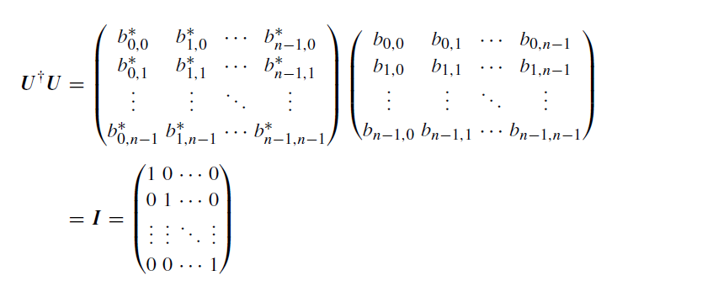
Unitary Matrix and Transformation
Prove
The column vectors in a unitary matrix are orthonormal.

Slide 9





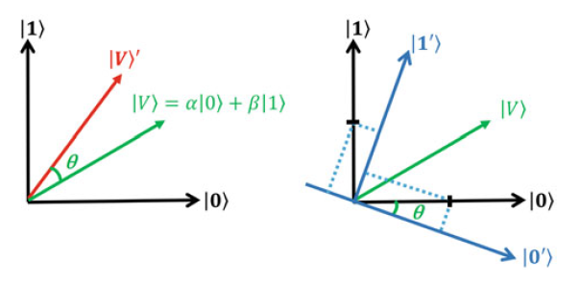
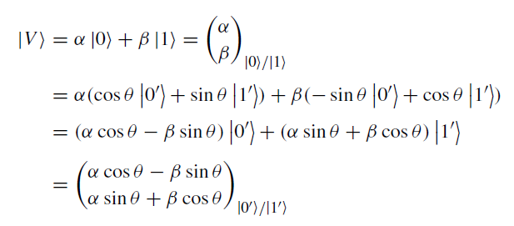

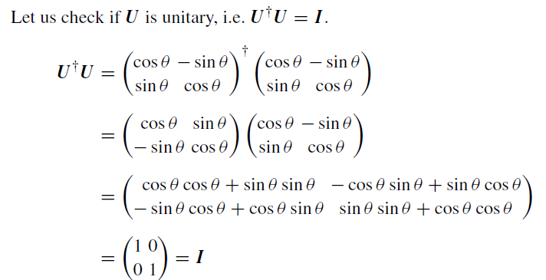
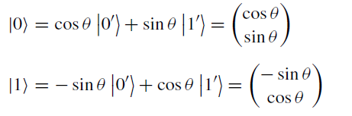
Example of Unitary Transformation

Slide 10
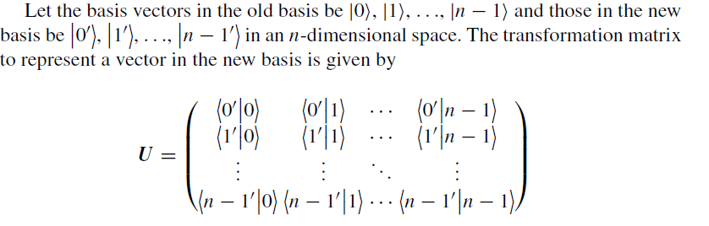
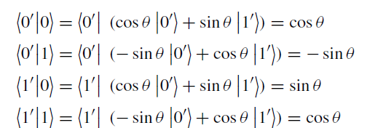

How to find transformation matrix

Slide 11




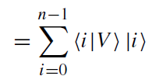
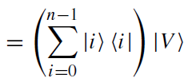


Completeness of Basis
Completeness: Can represent every vector in the space.
After substitution

Slide 12


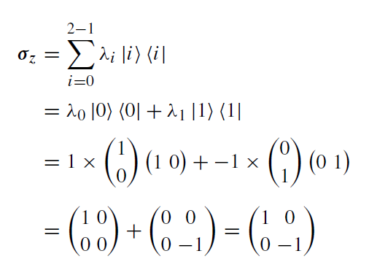
Construct Operator from Eigenvectors and Eigenvalues

